Slide 1

Amazon S3 (Simple Storage Service)
What is Amazon S3?
An object storage service offering industry-leading scalability, availability, security, and performance.
Allows you to store and protect any amount of data from anywhere for use cases such as data lakes, cloud-native apps, machine learning, analytics, backup, and archive.
Key Features:
Durability & Availability: 99.999999999% (11 9's) durability, ensuring long-term data storage reliability for millions of customers.
Scalability: Automatically scales storage to meet growing demand.
Security: Provides end-to-end encryption (data at rest and in transit).
Cost-Efficient: Integrates with low-cost storage options like S3 Glacier for long-term archiving.

Slide 2
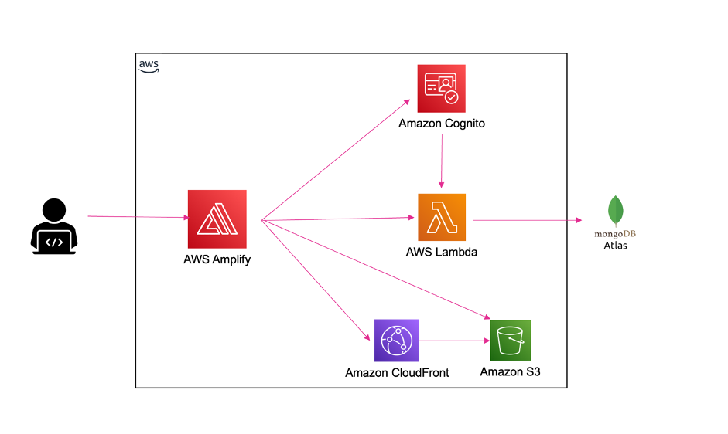
APPLICATIONS OF Amazon S3
Use Cases:
Data Lakes & Analytics: Enables running big data analytics, AI, and machine learning applications.
Cloud-Native Applications: Supports fast, scalable web and mobile apps.
Backup & Restore: Meets compliance and recovery requirements using S3’s replication features.
Archiving: Use S3 Glacier to store archived data at the lowest cost, simplifying long-term storage management.
Real-World Example:
BBC Archives: Migrated 25 PB of data to AWS using S3, transforming 100-year-old archives.
Carrier Global: Utilized S3 to scale AI-driven energy solutions.
Roche: Saved 90% in storage costs by automating data archiving with S3.
REFERENCE:
Amazon Web Services, Cloud Object Storage - Amazon S3. Retrieved From: Https://Aws.Amazon.Com/Pm/Serv-s3/?Gclid=cjwkcajw1nk4bhaweiwavuhpul36p7krrmvyejtspvnwaeqt69bywd3pfs1mnluq9n4z0fggktrvvxocbvuqavd_bwe&trk=c8974be7-bc21-436d-8108-722e8ab912e1&sc_channel=ps&ef_id=cjwkcajw1nk4bhaweiwavuhpul36p7krrmvyejtspvnwaeqt69bywd3pfs1mnluq9n4z0fggktrvvxocbvuqavd_bwe:g:s&s_kwcid=al!4422!3!645125274431!E!!G!!Amazon%20s3%20account!19574556914!145779857032

